Slide 1
Kubernetes Bootcamp
Containers 101

Slide 2
Kubernetes Bootcamp Agenda
1
What is containers?
2
Docker
3
Containers lifecycle
4
Registry
5
Tagging
Notes:
For ESI customers, the TPM/iTPM must be consulted & provide approval before CSC is implemented. Be sure to always align with TPMs/iTPMs if you are considering running a challenge with ESI customers.
Andrea Waugh Metzger: LOVE Skills Challenge! I had a 60% conversion rate for ACAs last year when I ran challenges

Slide 3
What is containers?
Notes:
Menti

Slide 4
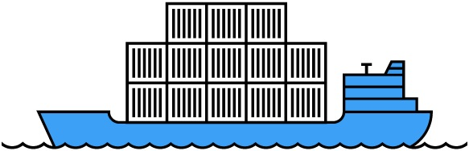
What is a container?
A method of operation system virtualization
A way to wrap an application into its own isolated box
Includes only the binaries needed to support the application
Isolates an app with its own view of the host from the perspectives of memory, CPU and network

Slide 5




Benefits of using containers
Any OS
Anywhere
Any app
Any language
Java
Linux
On-premises
Monolith
.Net
Python
Windows
Cloud
Microservice
Node

Slide 6
Benefits of using containers
Developers
IT Operations
Easily contain a local development environment |  | Containers are a single OS and are more efficient at resource utilization
Containers enable microservices architectures |  | Low overhead, allow for better performance and higher density
Containers allow for efficiency and agility |  | More secure by default and isolates resources
Empower CI/CD integration |  | Are faster to provision

Slide 7
Containers vs. Virtual Machines
App
Container
App
Virtual machines
Containers
Virtualize the hardware
VMs as units of scaling
Virtualize the operating system
Applications as units of scaling

Slide 8
Containers vs. Virtual Machines
Traditional virtualized environment
VM
VM
Low utilization of container resources
Containerization of applications and their dependencies for portability
Application
Con.
Con.
Application
Con.
Con.
From dev to production agility across development and operations teams
Hypervisor 2
Host OS
Hardware

Slide 9
Containers vs. Virtual Machines
Containerized environment
Migrate containers and their dependencies to underutilized VMs for improved density and isolation
VM
VM
Con.
Con.
Decommission unused resources for efficiency gains and cost savings
Con.
Con.
Container is lighter weight and faster to scale dynamically
Docker Engine
Host OS
Hardware

Slide 10
Docker

Slide 11
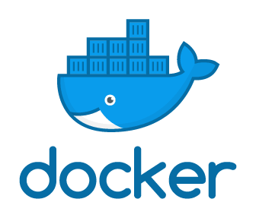
What is Docker?
Open-source software to build and manage containers.
Docker separates the application from the infrastructure using container technology
“Dockerized” apps can run anywhere on anything
No more dependency daemons so developers and system admins unite

Slide 12
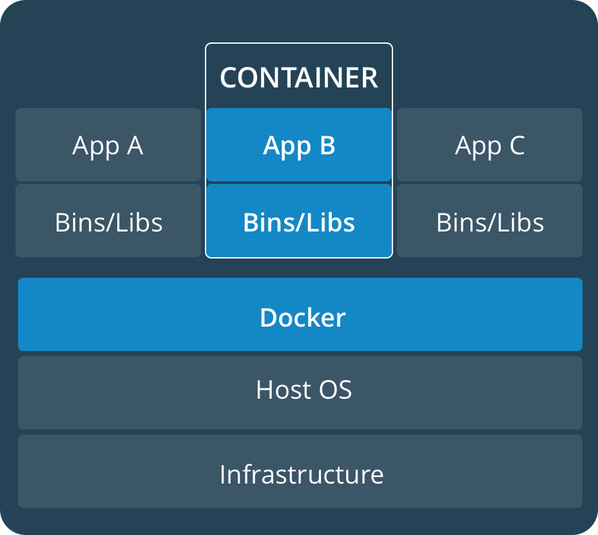
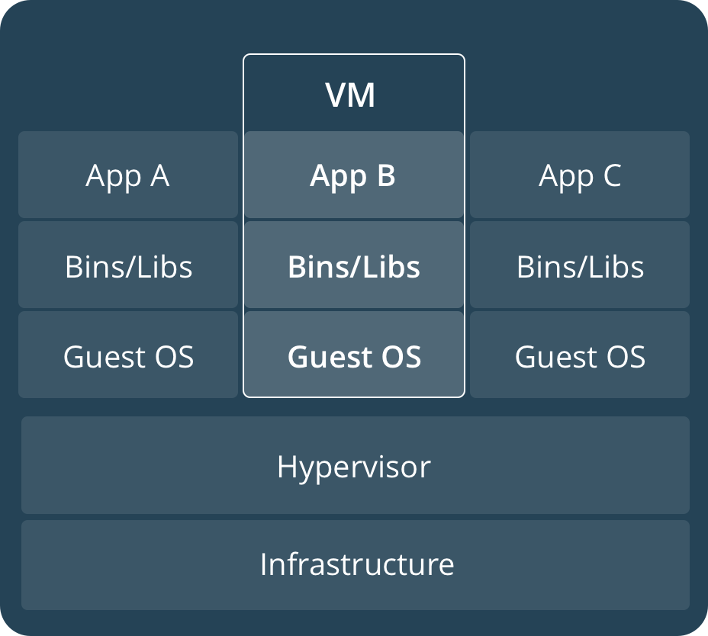
What is Docker?

Slide 13
What is Docker?
Host A VM running the Docker daemon to host a collection of Docker containers
Client Where Docker commands are executed
Daemon The background service running on the host that manages building, running and distributing Docker containers
Image An ordered collection of filesystems (layers) to be used when instancing a container (more on it later)
Container A runtime instance of an image
Registry A service that provides access to repositories, either through Docker Hub or Azure Container Registry

Slide 14
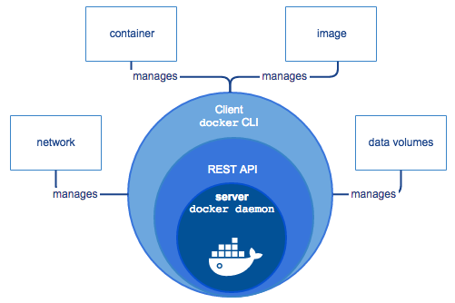
What is Docker?
Docker is a Client-Server application used for managing Containers on a host
Docker is the vessel by which container images are packaged and delivered
Docker Daemon: runs on a Container Host
Builds, runs and distributes containers
Client accesses via Sockets through REST API
Docker Client: interface to docker daemon
Uses Command Line interface (i.e. docker.exe)
Client can connect to a local or remote docker daemon

Slide 15
Linux and Windows Containers
Docker has been available for Linux since 2008
Linux as Host
Linux as SO for the Container
Partnership with Microsoft bring Containers to Windows
Windows as Host can run Linux and Windows Containers
Windows Containers are available on Windows Server 2016 and 2019

Slide 16
Windows Containers
Windows
Automation workloads
Carries most Windows OSS components
Windows Server Core
Minimal installation of Windows Server
Contains only core OS features
Command-line access only
Nano Server
Available only as container base OS image (no VM support)
20 times smaller than Server Core
Headless – no logon or GUI
Optimized for .NET Core applications

Slide 17
Containers lifecycle

Slide 18

Containers Images
What is a container image?
Analogous to a VHD + Config for Virtual Machines
Read-only templates for containers
Can depend on other images
Built up from a series of layers.
Image
Metadata Name,
Creation Data,
Command To Execute,
Dependences
Payload
Files
Folders

Slide 19
Containers Images
My Website
Application
IIS
Application Framework
Base Image (OS)

Slide 20
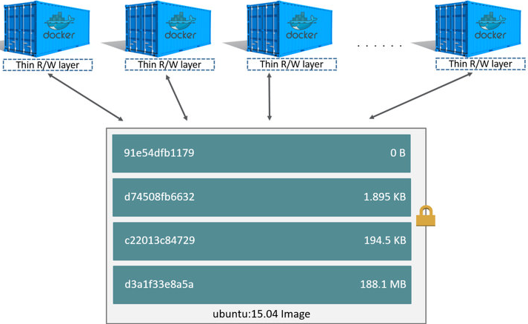
Containers Images
Each container has its own writable container layer
All changes are stored in this container layer
Multiple containers can share access to the same underlying image but have their own data state

Slide 21
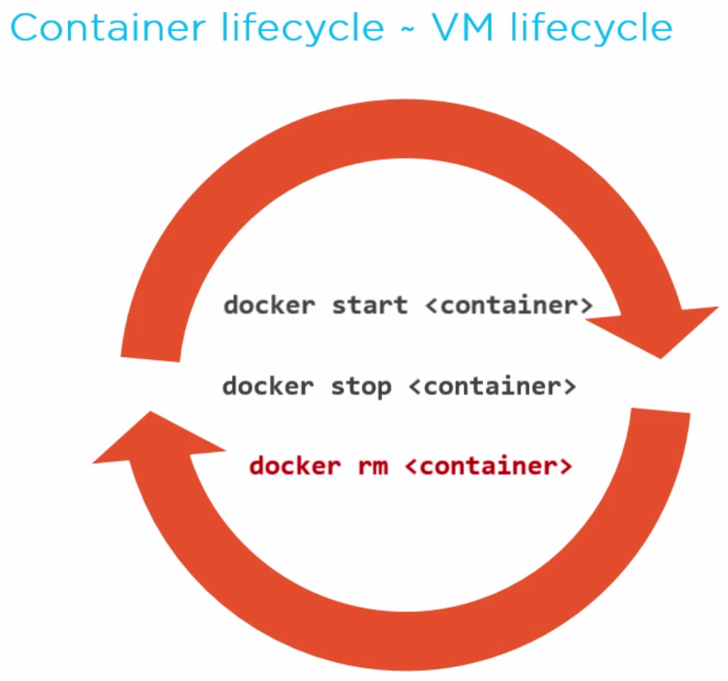
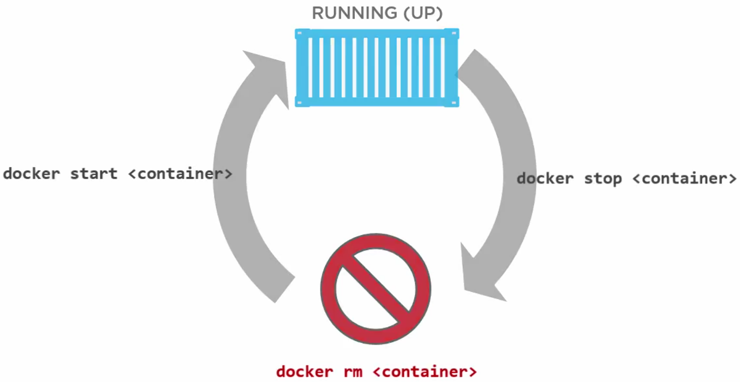
Lifecycle

Slide 22
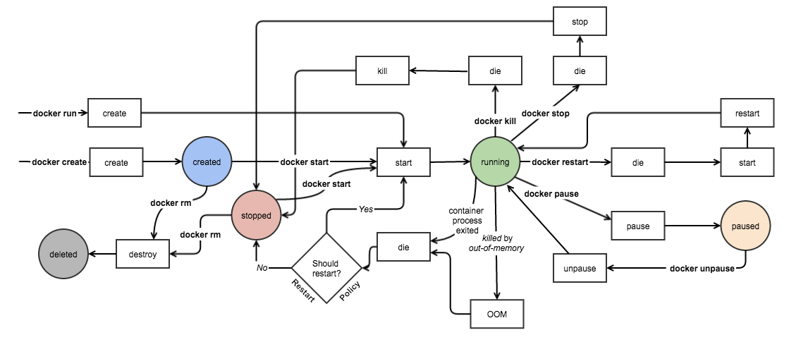
Lifecycle

Slide 23
Lifecycle
docker run -> Runs a command in new container
docker start -> Start one or more stopped containers
docker stop -> Stop one or more running containers
docker images -> List images
docker ps -> List Docker containers.
docker rm -> Remove one or more containers
docker rmi -> Remove one or more images

Slide 24
Demo

Slide 25









Docker In Action
Client
DOCKER_HOST
Registry
Docker run
Docker daemon
Containers
Images Cache
WordPress
WordPress

Slide 26
Registry

Slide 27
Image Registry
What is a registry?
Discovery
Storage
Distribution
Image Registry stores container images
Images are Pushed into a registry
Images are Pulled from a registry
Images are Searched for within a registry

Slide 28
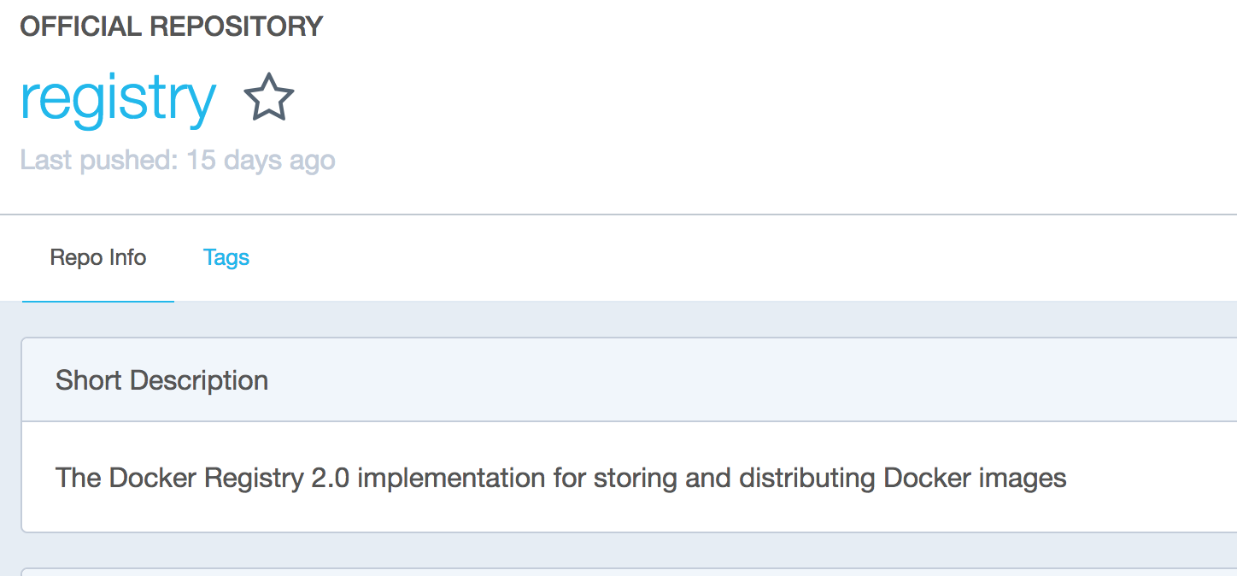
Image Registry
Registry is a stateless, highly scalable server side application that stores and lets you distribute Docker images.
Usage Pattern:
Tightly control where your images are being stored
Fully own your images distribution pipeline
Integrate image storage and distribution tightly into your in-house development workflow
Public (DockerHub) / Private

Slide 29
Image Registry
Docker Hub and Docker Store
Public, official and private image repositories
Granular access controls with organization support
Automated image build support
Azure Container Registry (ACR)
Store and manage container images across Azure deployments
Maintain Windows and Linux container images
Same API and Tools as Docker Hub/Store/Registry
Supports hosting private registry with fine grain Role Based Access Control for management
Can be geo-redundant making it faster to download/upload images based on client location

Slide 30
Image Registry
docker pull -> Pull an image or a repository from a registry
docker push -> Push an image or a repository to a registry
docker search -> Search the Docker Hub for images

Slide 31
Tagging

Slide 32
Image Tag
Image name is composed by
registry-server/repository:tag
registry-server
Define where the image were pulled
When omitted means “docker.io”
repository
Define the name of the image
Can be composed by several levels using ‘/’ as divider
tag
Define the version of the image
When omitted gets the value “latest”. So “latest” really means “no tag”.

Slide 33
Image Tag
Tag value is textual and open
Important to identify the image with unique value
An image with a specific tag on a registry could be overwritten
“latest” tag should be used very carefully
Examples
1.0
beta
5.0-alpine
20210506.1

Slide 34
Demo

Slide 35
Lab
Run Docker containers with Azure Container Instances - Learn | Microsoft Docs

